Slide 1

MES 503 Lab 6
Kayla Blincow, PhD

Slide 2

Announcements
Lab assignment 2 due today

Slide 3


Slide 4
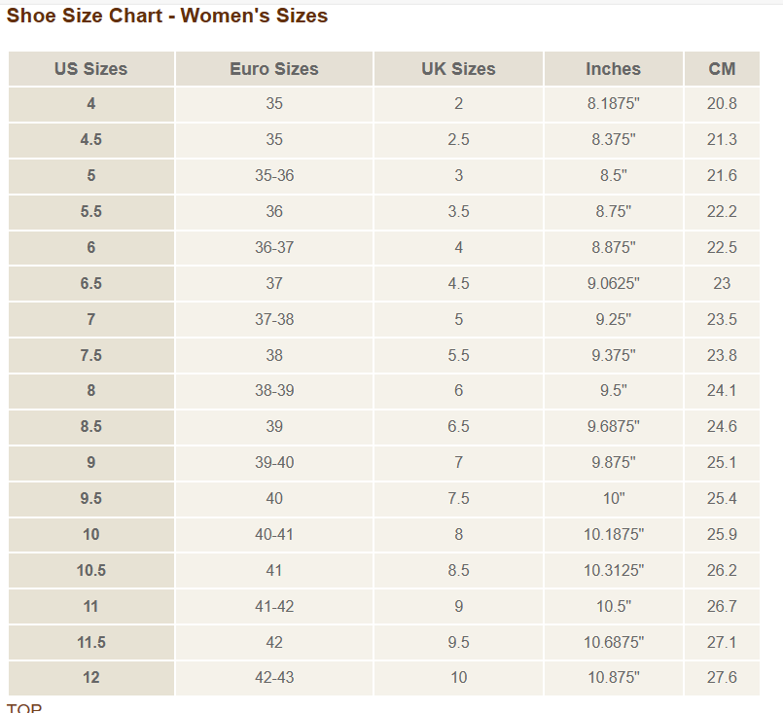
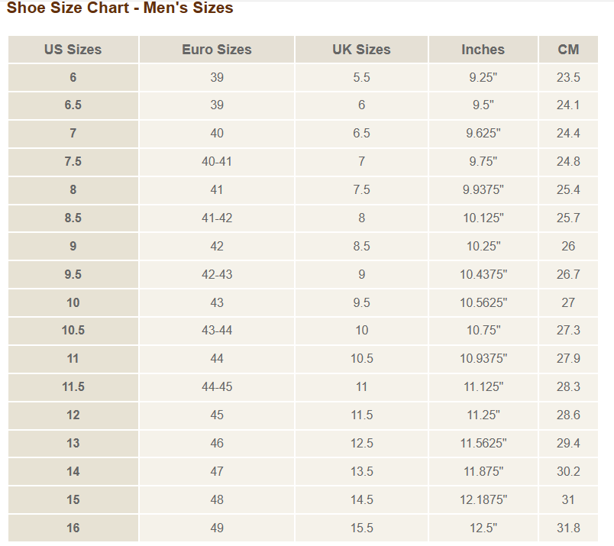
Notes:
It’s thought that the length of your forearm is a good estimate of the length of your foot… Let’s try it! Can we predict foot length based on forearm length?

Slide 5
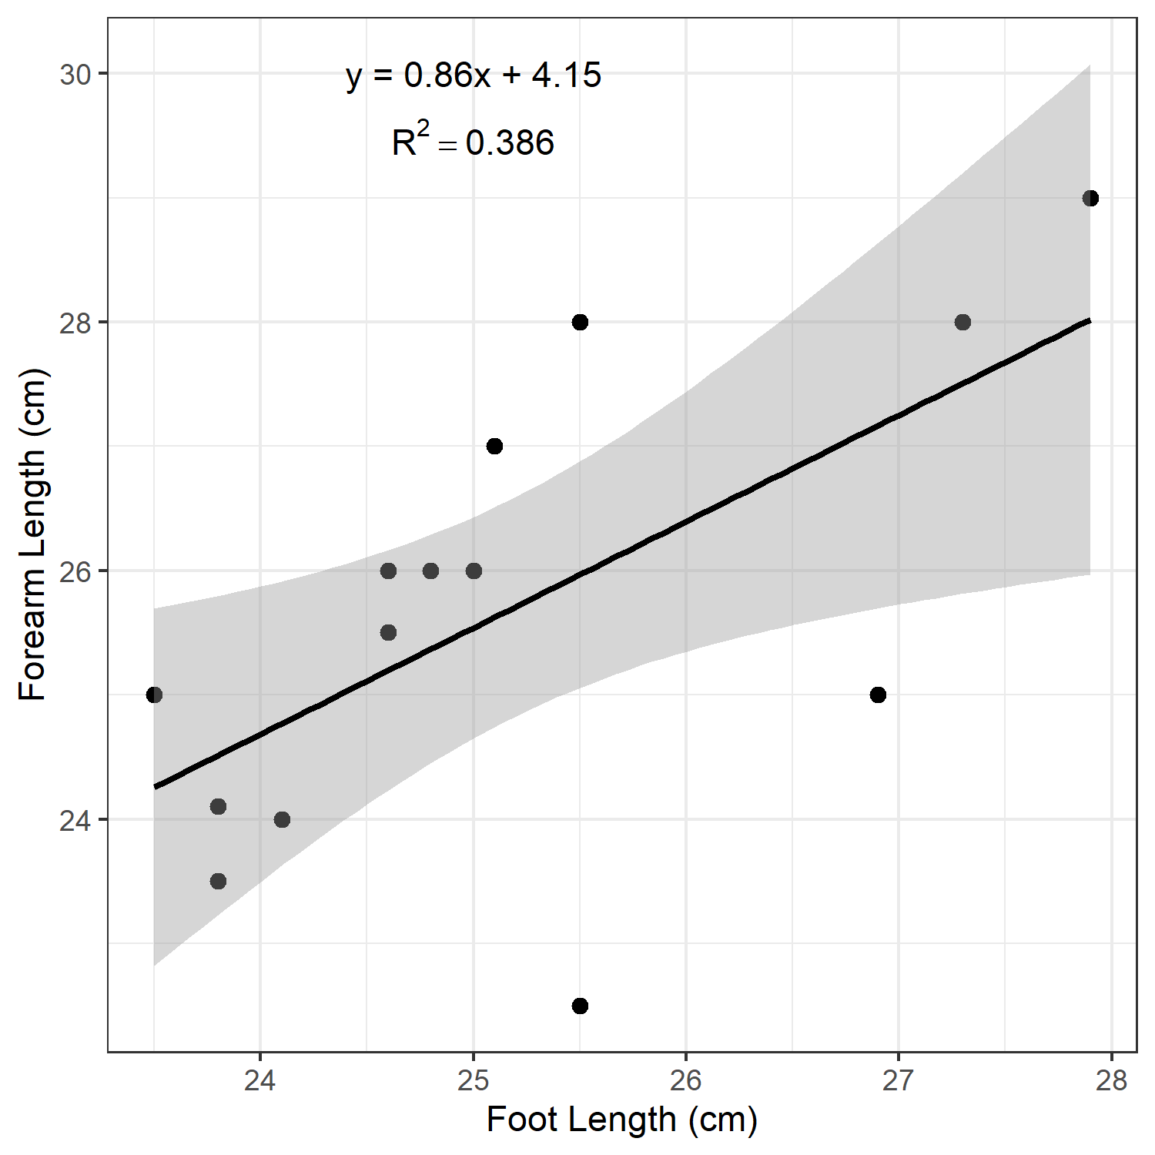
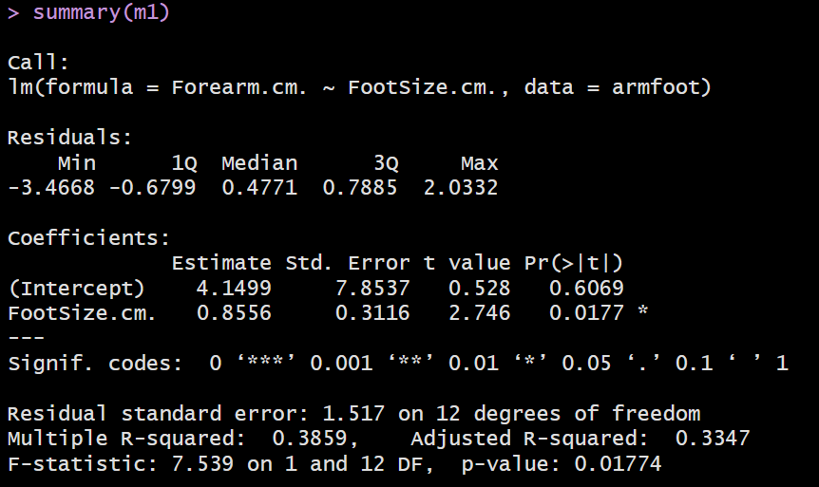

Slide 6
Notes:
Distribution of residuals – recall we want normally distributed residuals (i.e. median ~0, and even distribution on either side) – we aren’t exactly on here, but it’s not terrible either

Slide 7
Notes:
Linear regression coefficients are evaluated with a t-value to test whether the relationship between a predictor variable and the outcome is statistically significant or just due to random chance.
How the t-value Works
Measuring signal versus noise: The t-value is calculated by dividing the estimated coefficient (beta) by its standard error (the measure of uncertainty or noise in the estimate).
Distance from zero: It tells you how many standard errors the coefficient is away from zero.
Testing the null hypothesis: A coefficient of zero means there is no linear relationship. A large absolute t-value (typically greater than 2) means the effect is large relative to its uncertainty, allowing you to reject the null hypothesis and conclude the variable has a real effect.
Why a t-distribution?
Unknown population variance: Because the true population error variance is unknown and must be estimated from a limited sample, the statistic follows a Student’s t-distribution rather than a normal z-distribution. This accounts for extra uncertainty when sample sizes are small.

Slide 8
Notes:
Distribution of residuals – recall we want normally distributed residuals (i.e. median ~0, and even distribution on either side) – we aren’t exactly on here, but it’s not terrible either

Slide 9
Notes:
Distribution of residuals – recall we want normally distributed residuals (i.e. median ~0, and even distribution on either side) – we aren’t exactly on here, but it’s not terrible either

Slide 10
Reporting Regression Results
There was a significant relationship between [independent variable] and [dependent variable] (R2 = [R2 value], F(df regression, df residual) = [F-value], p = [p-value]).
[independent variable] significantly predicted [dependent variable] (β = [β-value], p = [p-value]).

Slide 11
There was a significant relationship between the length of foot and the length of the forearm (R2 = 0.386, F(1, 12) = 7.539, p = 0.018. The length of the foot significantly predicted the length of the forearm (β = 0.86, p = 0.018).

Slide 12
Switch to ze code!

Slide 13
TODAY!
More Giant Sea Bass

Slide 14

Importance of Trophic Ecology
Understand how recovery might impact ecosystem dynamics
  Predators can have disproportionate influence (e.g. Donohue et al. 2017)
Roger Carlson
Notes:
As high level predators, GSBs have the potential to strongly influence ecosystem dynamics, especially considering they are returning after an over 50 year absence from SoCal waters. As you can imagine increasing the number of these guys cruising around sucking things up is likely to influence the ecosystem. But in what ways? Need an understanding of what they eat and their role in the trophic system to understand how best to manage their ongoing recovery in the context of the broader ecosystem impacts.

Slide 15
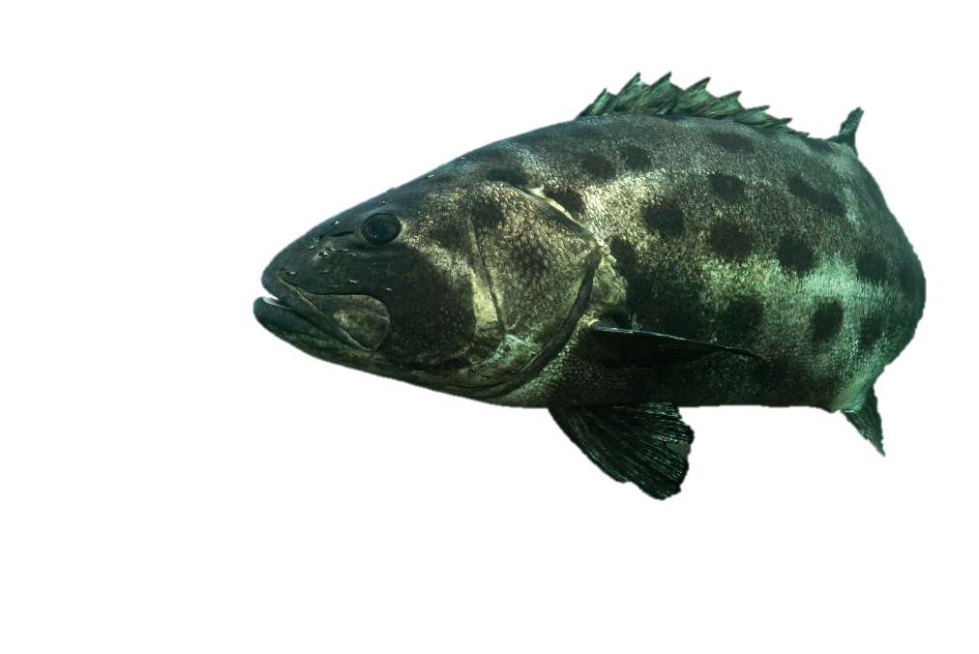


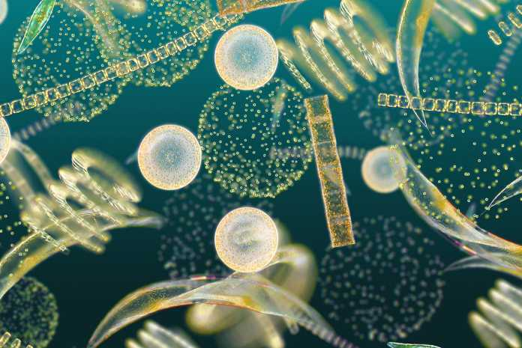


Stable Isotope Analysis
Bulk Stable Isotopes
δ¹⁵N
¹³C
¹⁵N
δ¹³C
Notes:
Carbon ratio on x axis, N ratio on y axis. By looking at the carbon isotopes of a GSB, we can get a sense for which primary producers are supporting it at the base of the food chain, because C ratios are relatively conserved as you move up the food chain. Nitrogen isotopes are useful because they enrich as you move up the food chain. Animals tend to metabolize the lighter N14 isotope over the N15 isotope, and this causes N15 to enrich as you move up the food chain. As result, we can use N ratios provide information about the relative trophic position of an organism.

Slide 16
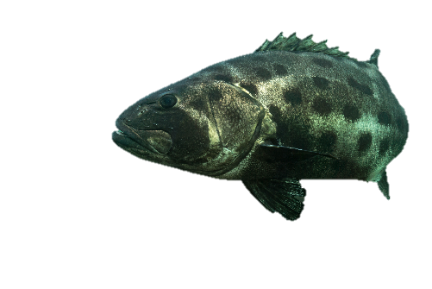
Stable Isotope Analysis
Bulk Stable Isotopes
δ¹⁵N
¹³C
¹⁵N
δ¹³C
Notes:
For example, we might have tissue samples from two separate GSBs and they fall here in isotope space. This one is likely reliant on macroalgae primary producers at the base of it’s food chain because it’s C signature aligns with macroalgae, while this other one is likely reliant on phytoplankton primary producers. Look at their positions on the y axis, we can infer that this one is probably occupying a higher trophic level than the other, because it has a higher N15 ratio.

Slide 17

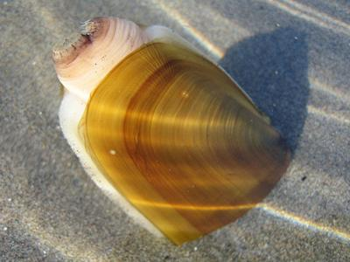
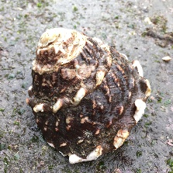
Stable Isotope Analysis
Bulk Stable Isotopes
δ¹⁵N
¹³C
¹⁵N
δ¹³C
Notes:
To demonstrate the reason we might see these differences in N ratios, we can think about the pathway of nitrogen form primary producers to GSBs. The GSB on the right might have eaten a lobster that had eaten a wavy turban snail that had eaten some kelp, so it has more trophic steps between the primary producer, kelp, to the GSB, leading to increased enrichment of N15. The GSB on the left ate a razor clam that was filter feeding phytoplankton, so it has fewer trophic steps making this individual occupy a lower trophic level and have a lower N15 ratio.

Slide 18

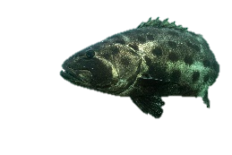
Stable Isotope Analysis
Bulk Stable Isotopes
δ¹⁵N
¹³C
¹⁵N
δ¹³C
Notes:
By comparing isotopic signatures across multiple GSB individuals we can get a sense of the trophic ecology of the species as a whole, but also how individuals and age groups within the species vary from each other. One way to do this is to statistically draw ellipses around defined groups and look at the area of the ellipse. We might imagine that the GSB samples in each of these ellipses are from different age classes. The yellow age class is really tightly clustered which suggests that GSBs from that group are eating really similar things, while the red age class has a much larger spread in isotopic space suggesting that GSBs in that group might be specializing in specific prey groups at the individual level.

Slide 19
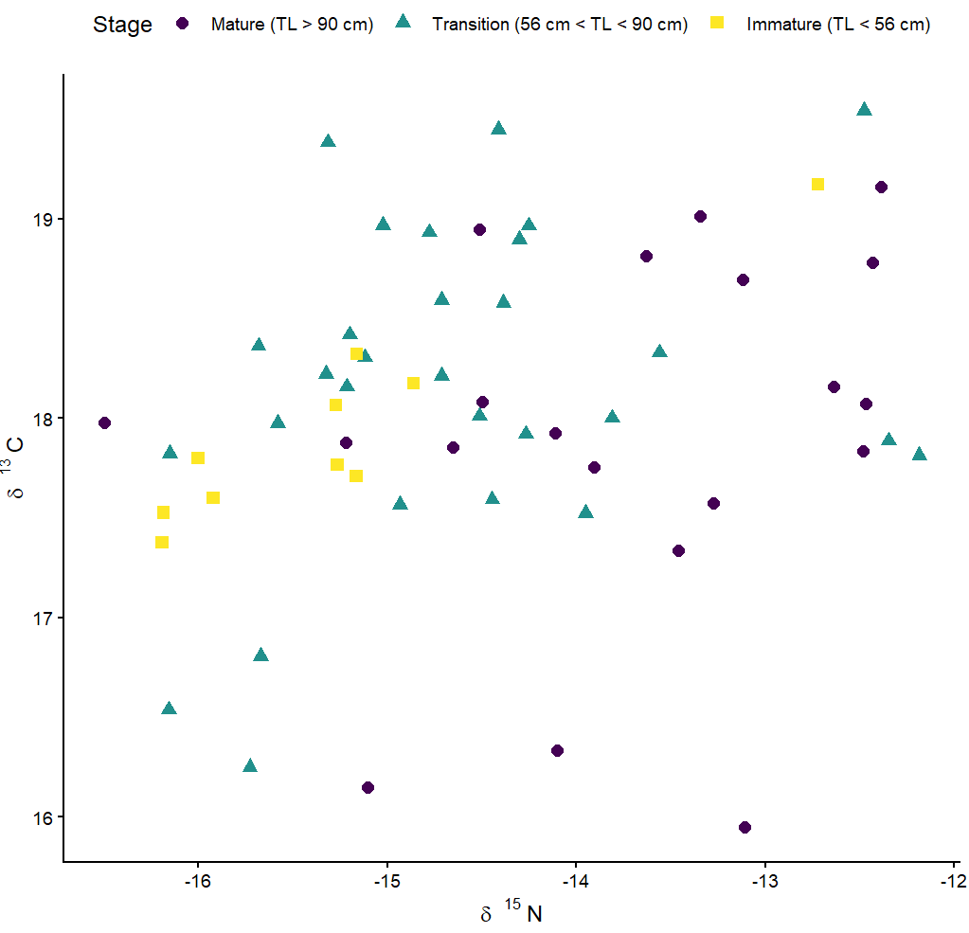

Slide 20
Extra Resources
How to Interpret P-values and Coefficients in Regression Analysis - Statistics By Jim
The Main Ideas of Fitting a Line to Data (The Main Ideas of Least Squares and Linear Regression.) - YouTube
Linear Regression, Clearly Explained!!! – YouTube
What are degrees of freedom in statistics? A simple explanation. - YouTube

